Slide 1
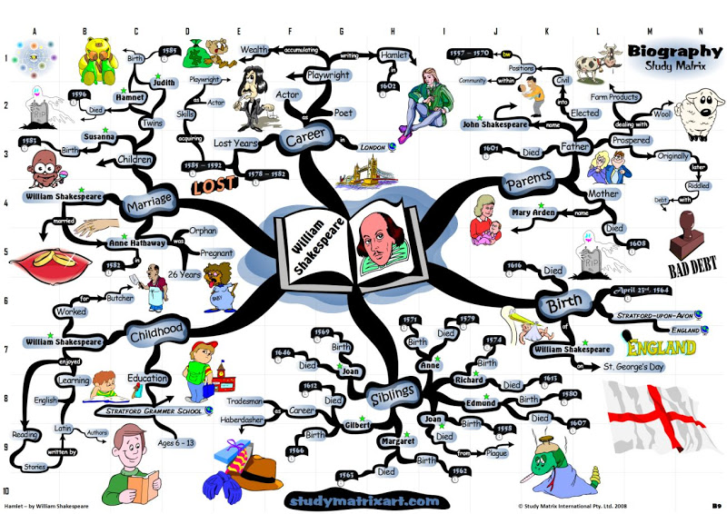
Elaborate and detailed! Branches are not colour coded Images are computer generated

Slide 2
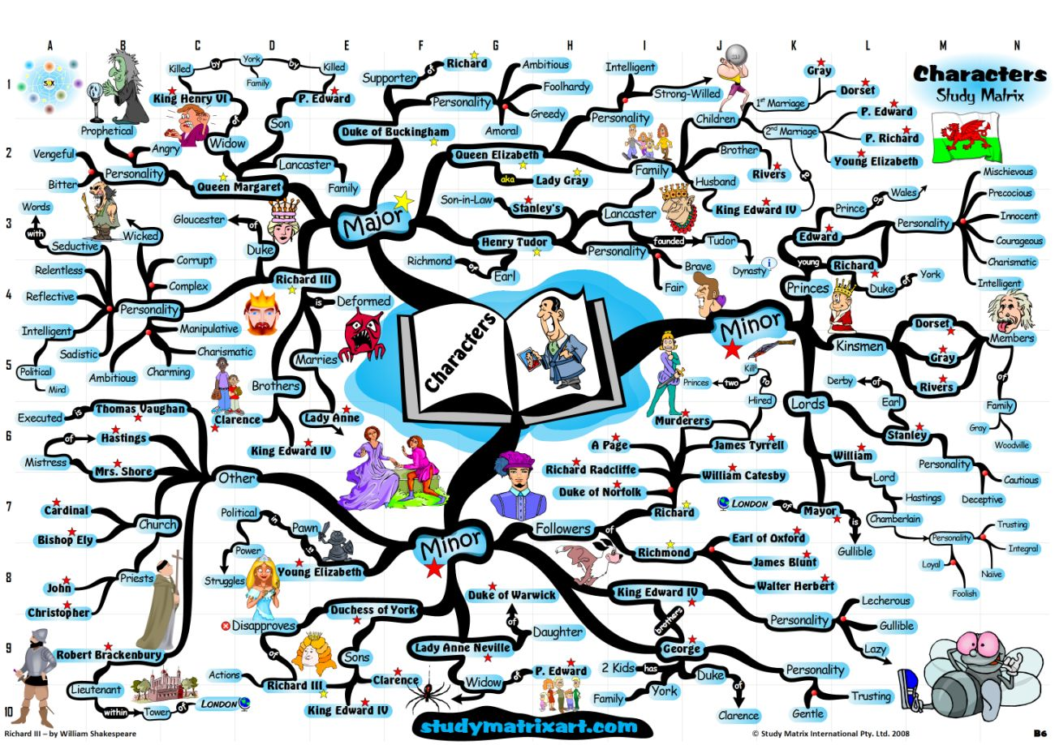
Well organized A lot of detail What’s missing?

Slide 3
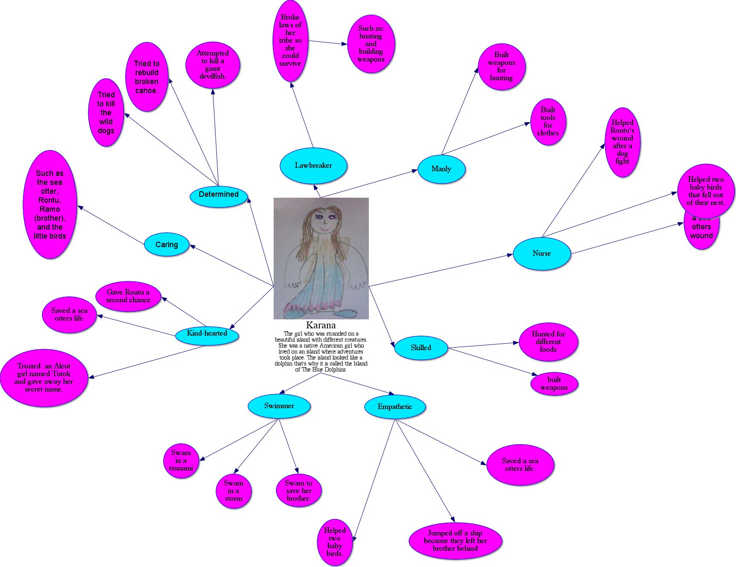
Computer assisted and simple Yours must be done by hand No images or symbols used Only 2 levels of detail

Slide 4
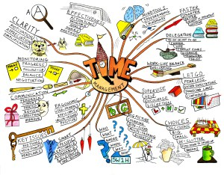
Great images Branches are not colour coded Obviously a different topic Several ideas under each topic

Slide 5
Colour coded More elements than needed Less specific detail Branch out, be specific Show what you know!

Slide 6
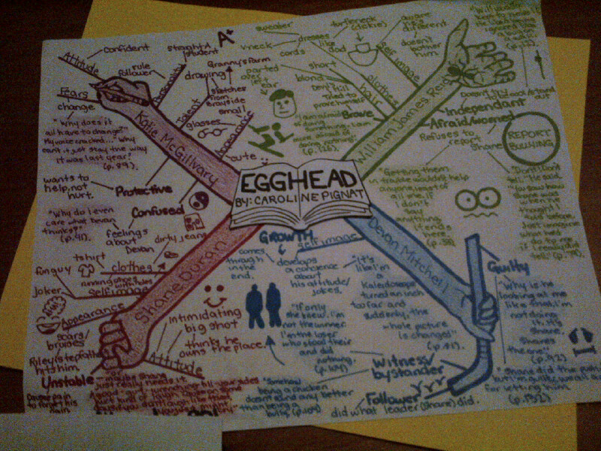
What do you notice about this one? What is different about what you are being asked to do?

Slide 7
What do you notice about the next 3 examples?

Slide 8
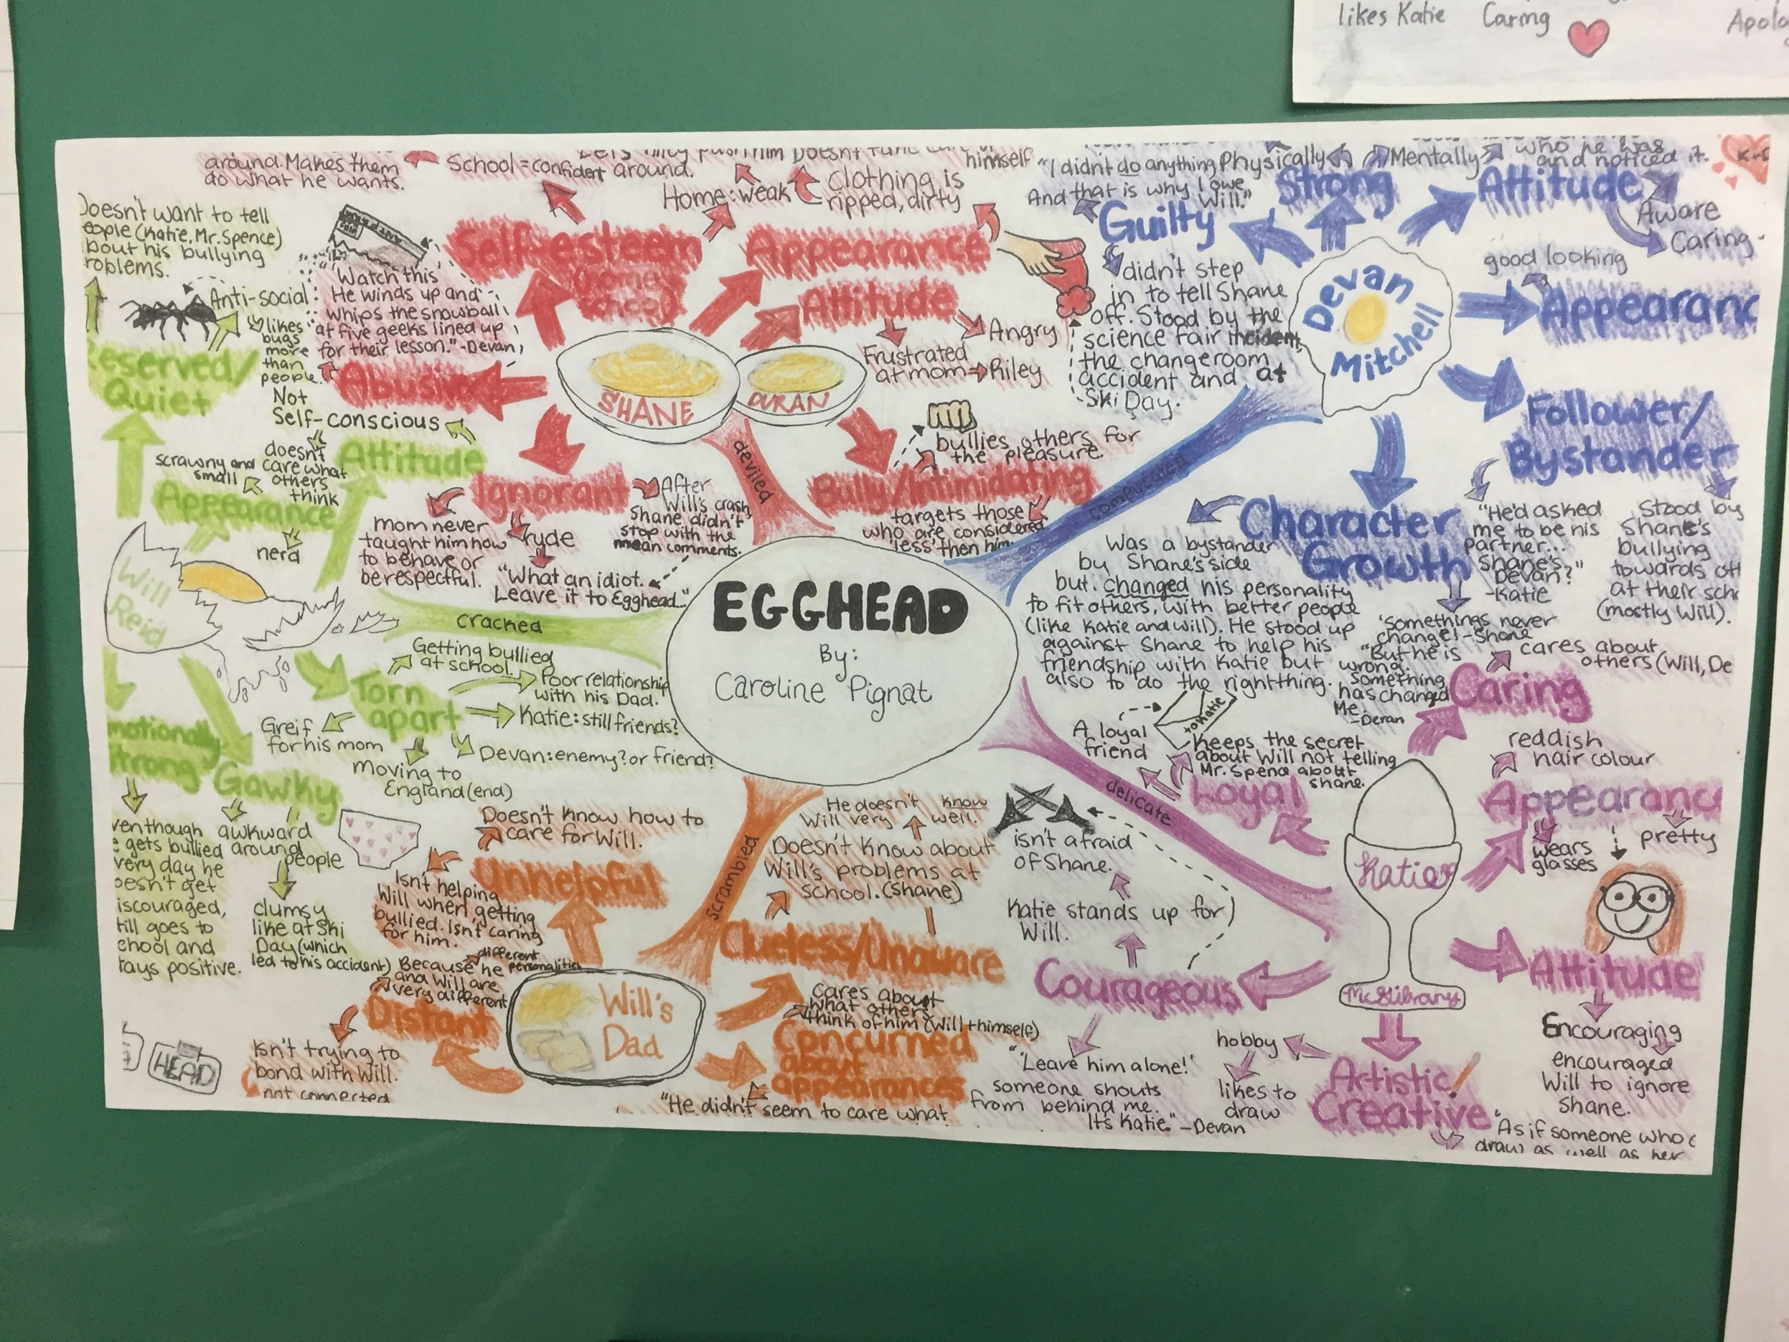

Slide 9
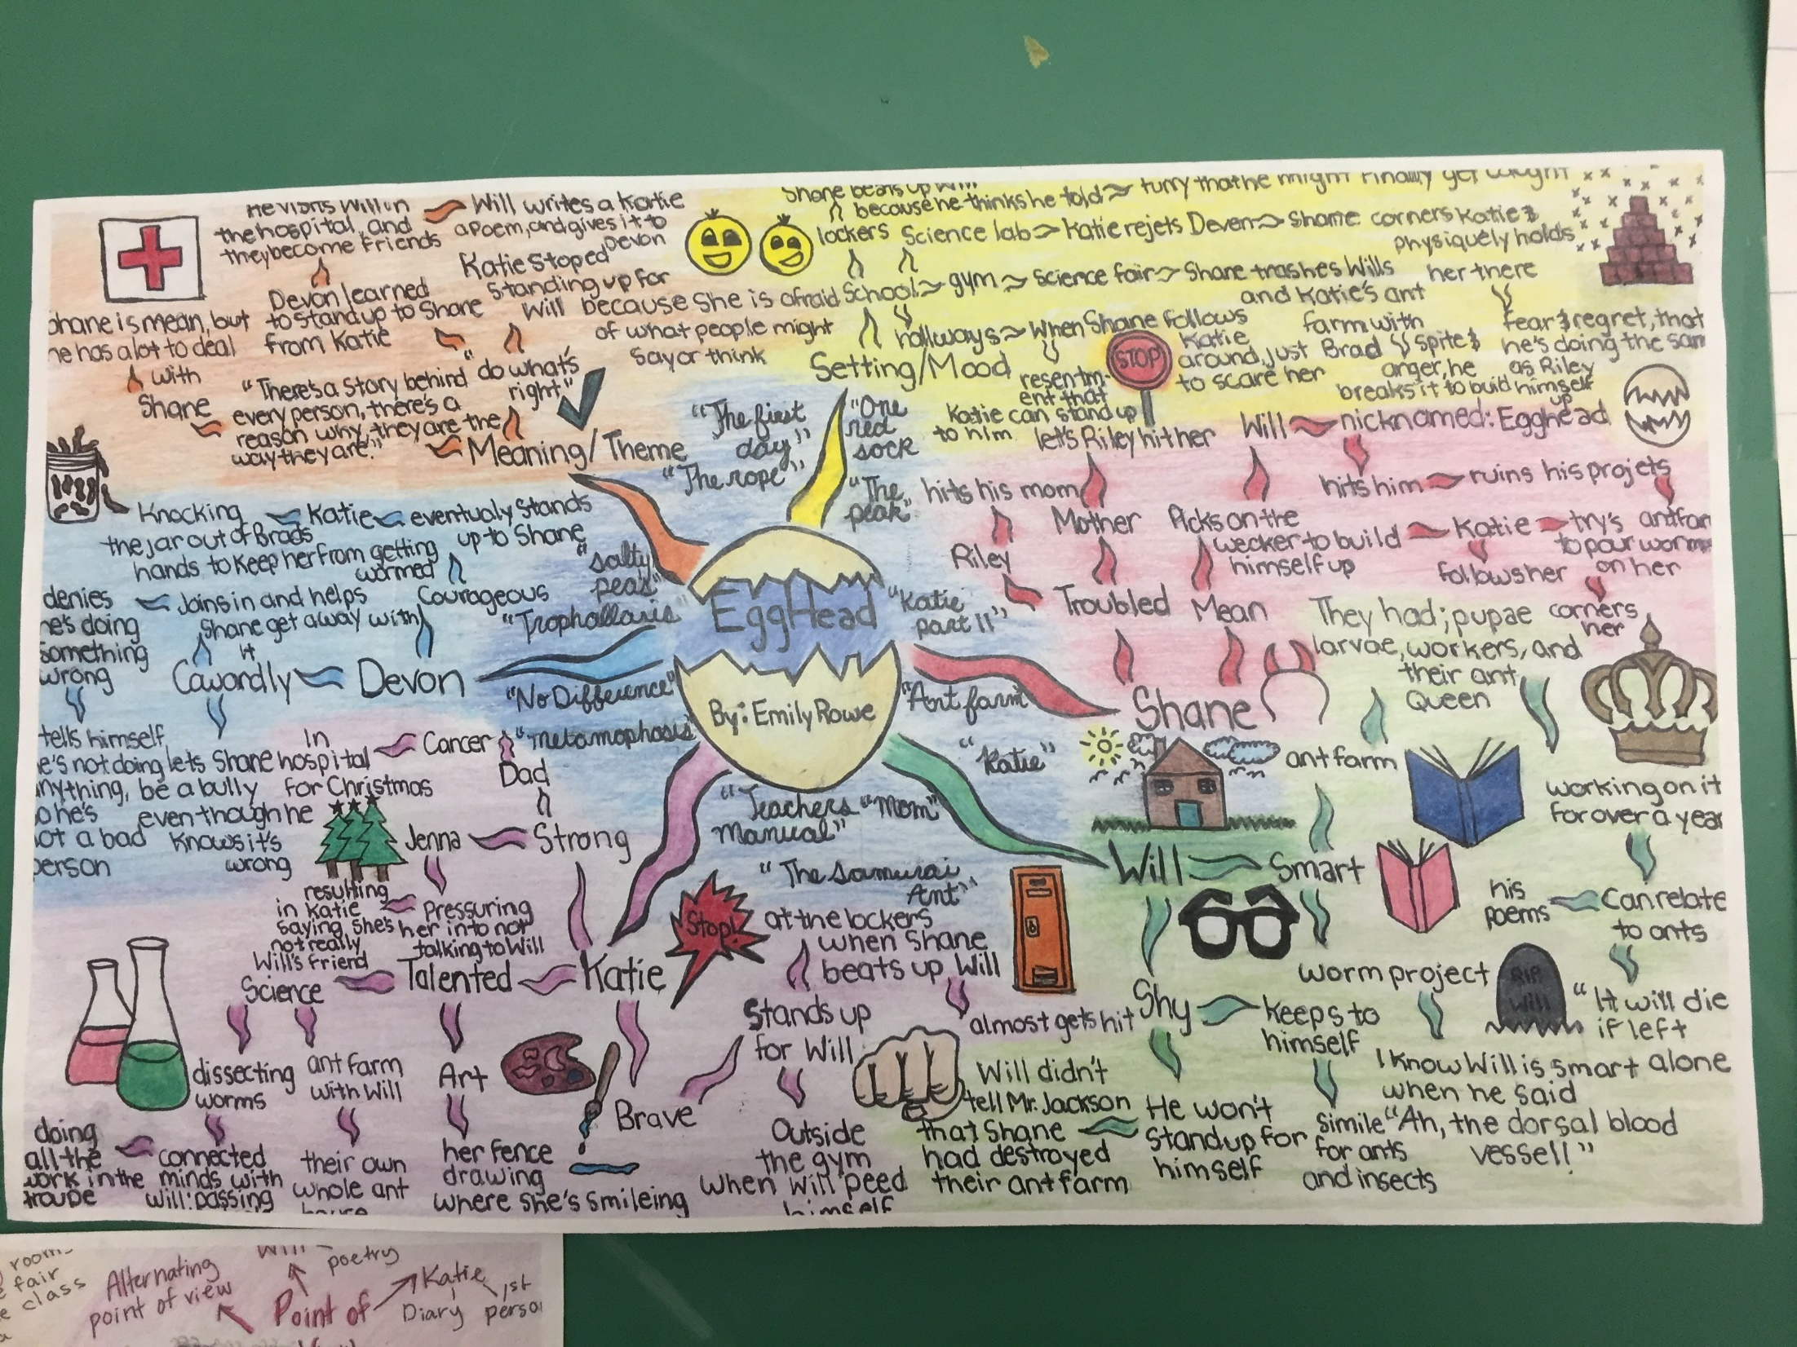

Slide 10
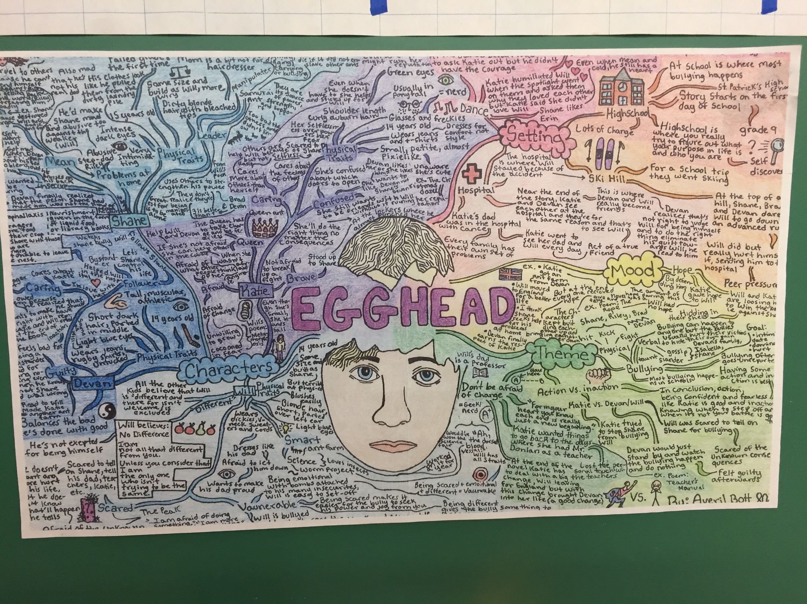

Slide 11
Now it’s your turn….how do you start???

